Slide 1

E-Book Library Management System
PG-Diploma in Advanced Computing
(C-DAC, ACTS (Pune))
Submitted By:
Rajni K Jambhulkar | (230940120149)
Samiksha R. Zod | (230940120169)
Sanjana Jawaria | (230940120171)
Shiv Tomar | (230940120188)
Prachiti P.Vaidya | (230940120219)

Slide 2


Introduction
Technique
Defination
Use Case Diagram
UML Activity Diagram
Implemenation
ER Diagram
Table
System Implementation
Future Scope

Slide 3

Introduction
Detection of text reg ions either from handw ritten or printed docu ment images containing va rious non-text ual info rmation is a di fficult task, and it can be more challenging to locate the position o f the text regions when we deal with a docto r’s prescription .
The E-Book Library Management System is a software solution designed to streamline the management of e books, genres, subscribed users, navigation data, plans, and user authentication in a digital library setting. This system aims to provide an efficient platform for users to access and manage e books, track their reading progress, and explore various genres. The system consists of several key components:
Entities
DTOs (Data Transfer Objects)
Repositorie
Services:
Controllers
Repositories
Objective
The objective of the BookNest Comprehensive Library Management System is to provide a robust and user-friendly platform for managing digital library resources, including ebooks, users, plans,
and navigation data. The system aims to streamline the process of accessing, organizing, and navigating through a diverse collection of ebooks while ensuring data security, scalability, and
performance. To provide an overview of the features and functionalities of the BookNest library management system.
To analyze the technology stack used in developing BookNest, including React, Spring Boot, and MySQL, and evaluate their suitability for the project.
To assess the usability and user experience of the BookNest interface for both librarians and patrons.

Slide 4
To evaluate the reliability, performance, and scalability of BookNest's backend infrastructure, particularly focusing on Spring Boot and MySQL.
To examine the security measures implemented in BookNest to protect sensitive data and prevent unauthorized access.
To analyze the impact of BookNest on streamlining library operations, including cataloging, membership management, checkout, and return processes.
To investigate any challenges encountered during the development and implementation of BookNest and the strategies employed to overcome them.
To gather feedback from librarians, administrators, and patrons regarding their experience with BookNest and identify areas for improvement.
Specifications :
E book Management
User Management
Plan Management
Navigation Tracking
Genre Management
Data Persistence
Security Measures

Slide 5
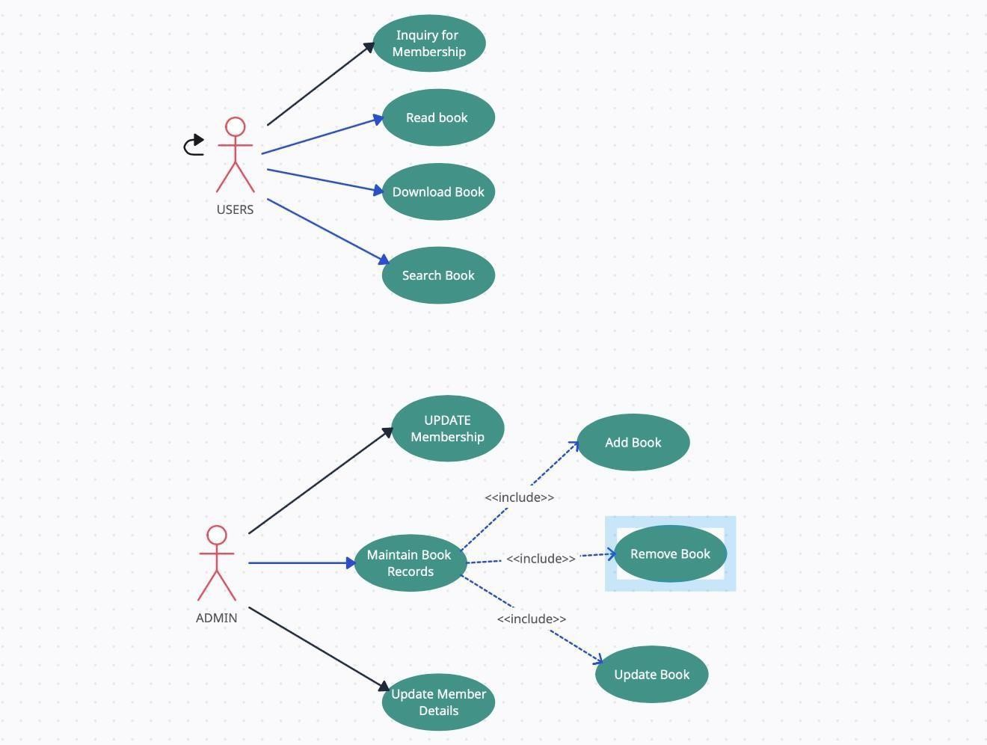
Use Case Diagram -

Slide 6
USE CASE DIAGRAM FOR VISITOR
Search books by book name, author name
visitor
visitor can read the Books if they subscribed the plan
Vis itor can take subscription of 3,6,12 months.
After Entering to the Homepage of the website , Visitor can choose the user USER LOGIN option where they are asked to enter username and password , and if he/she is a valid user then a user login page will be display.

Slide 7
System design-
ER Diagram-

Slide 8
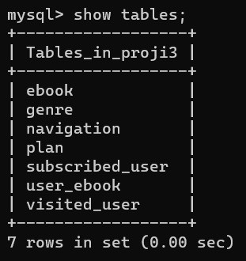
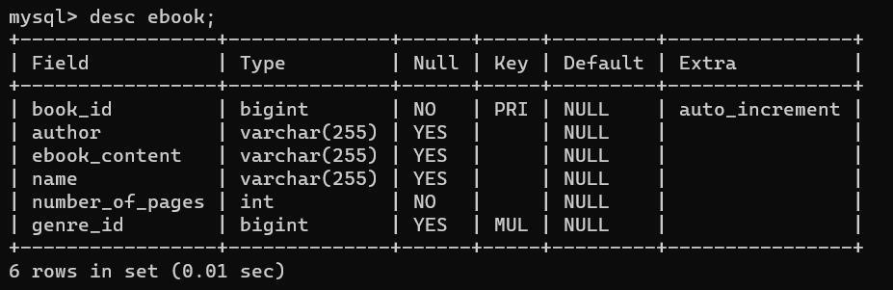
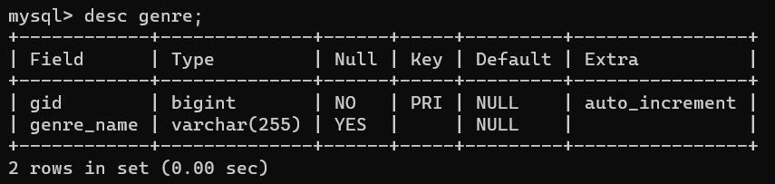
TABLES
Table from database( proji 3) –
E book Table -
Genre table from Database –

Slide 9
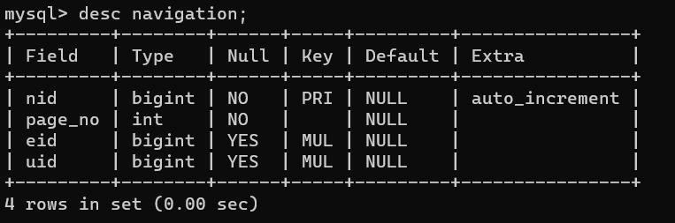
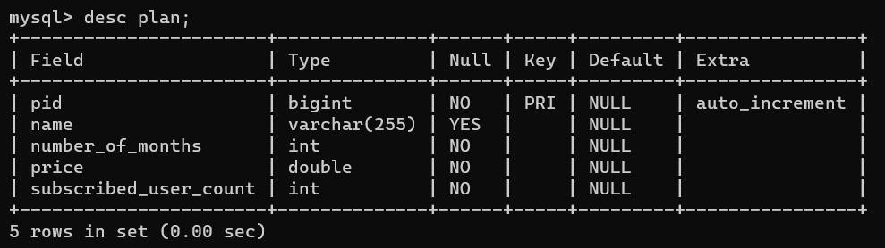
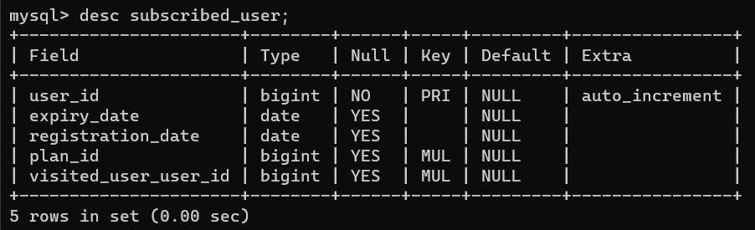
Navigation Table from Database-
Plan table from Database-
Subscribed user table from Database -

Slide 10
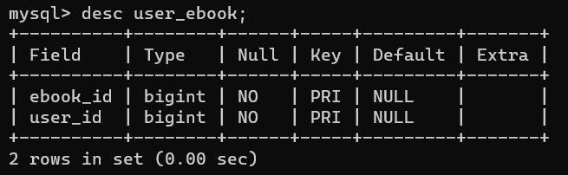
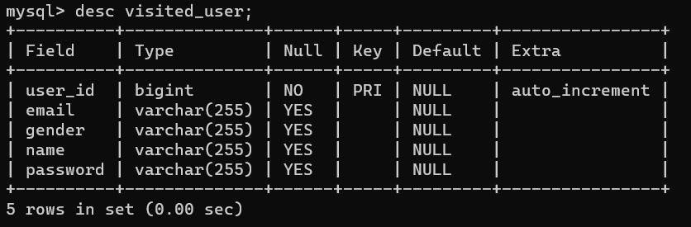
User e book table from Database-
Visited User table from Database-

Slide 11
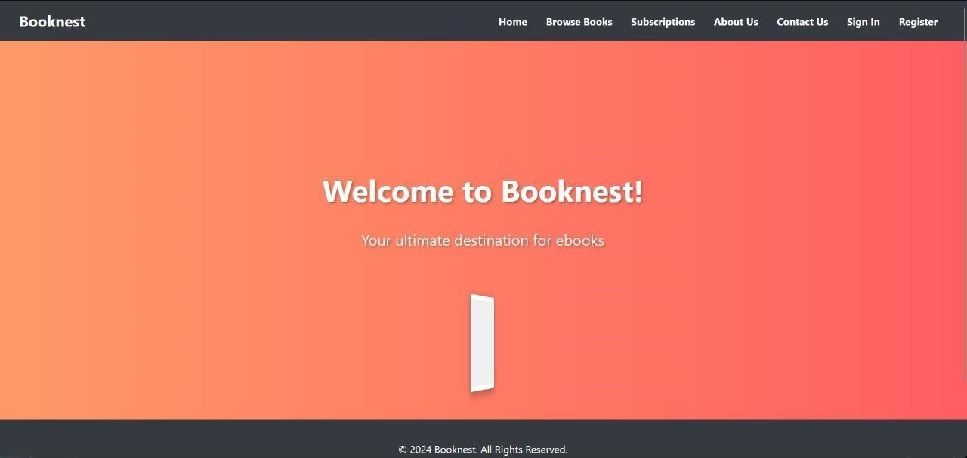
SYSTEM IMPLEMENTATION
Screenshot for Welcome page-

Slide 12
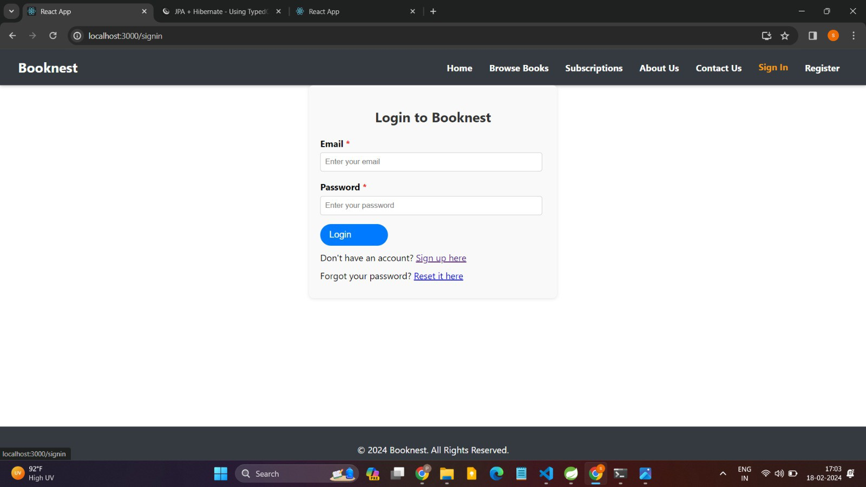
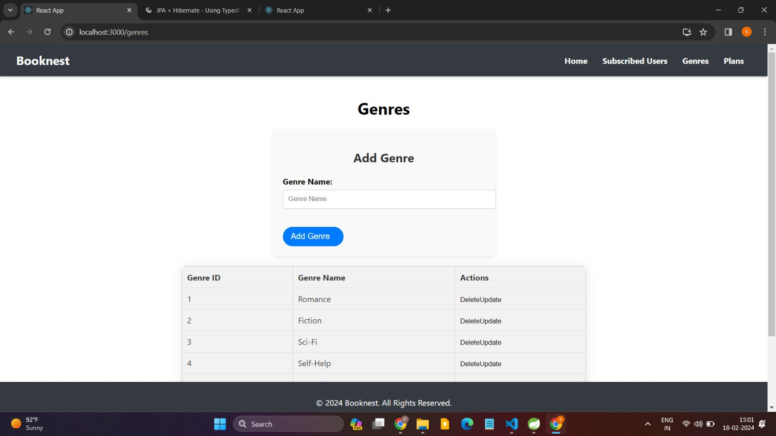
Admin login -
Screenshot of Add Genre for Admin-

Slide 13
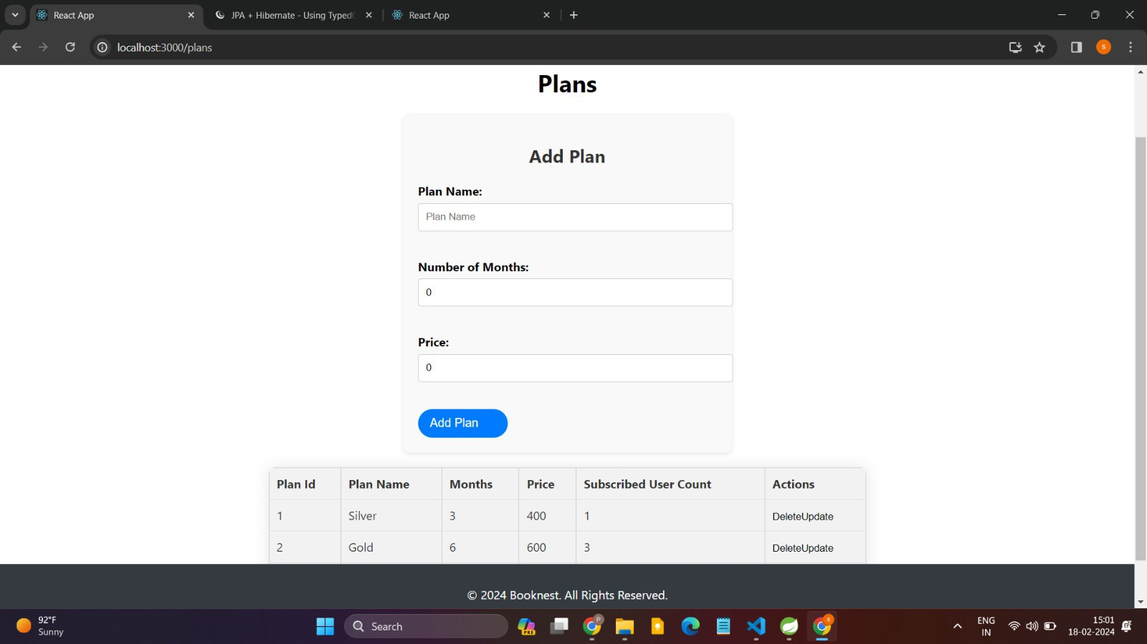
Screenshot of Add plan for Admin-
Add Book for Admin-
REGISTER NEW BOOK
This feature allows to add new books to the library.
Functional requirements
System must be able to verify information.
System must be able to enter number of copies into table.
System must be able to not allow two books having same book id.

Slide 14
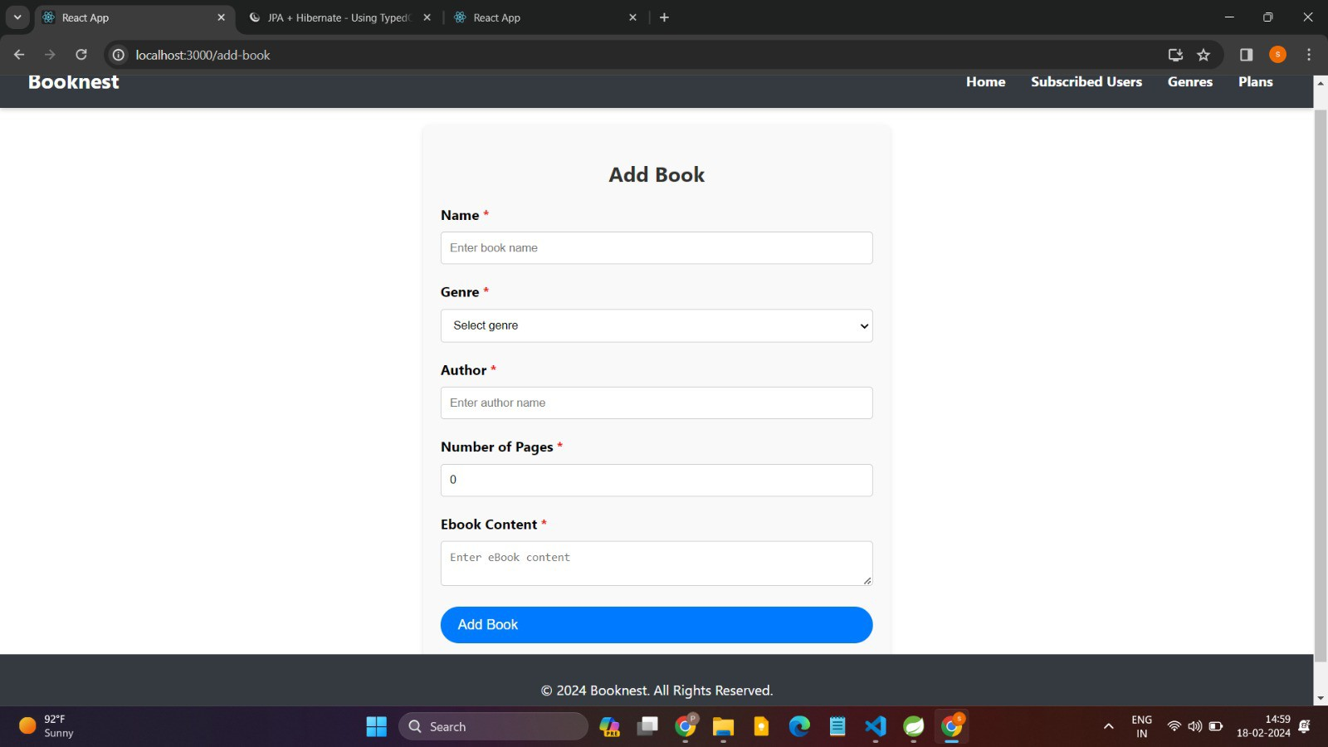
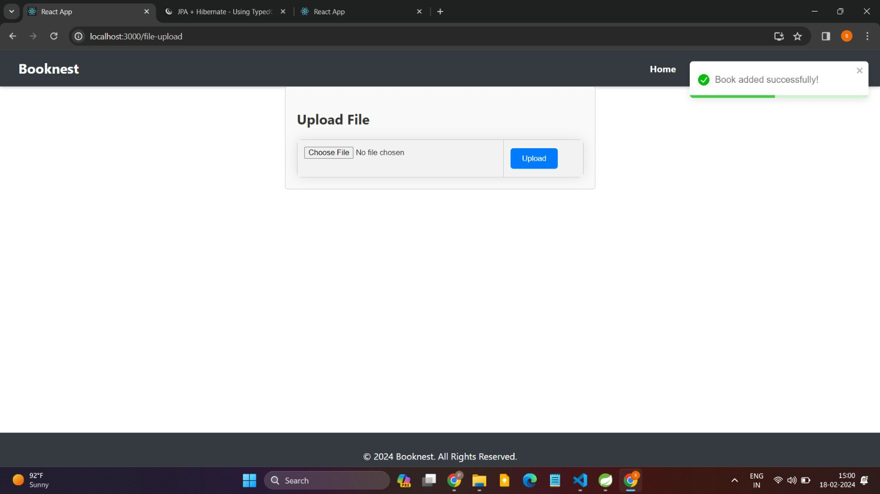
Upload book for Admin-

Slide 15
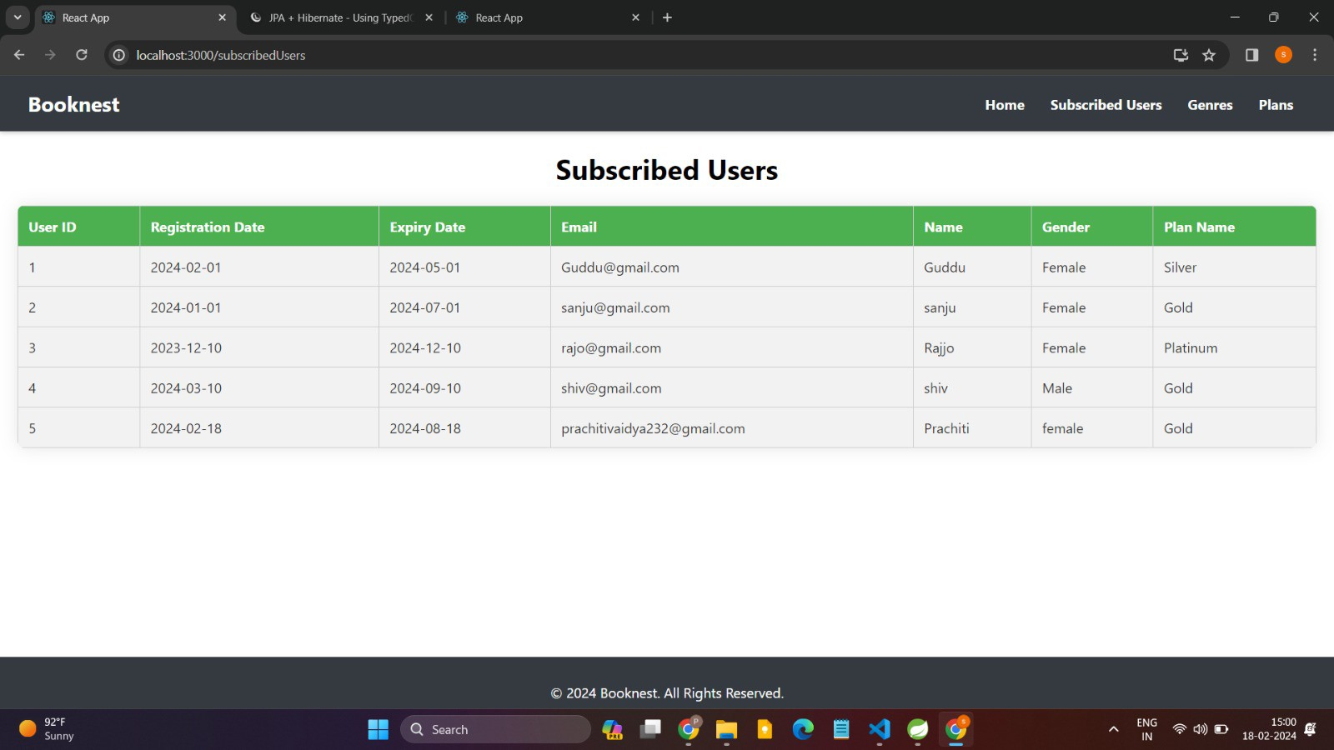
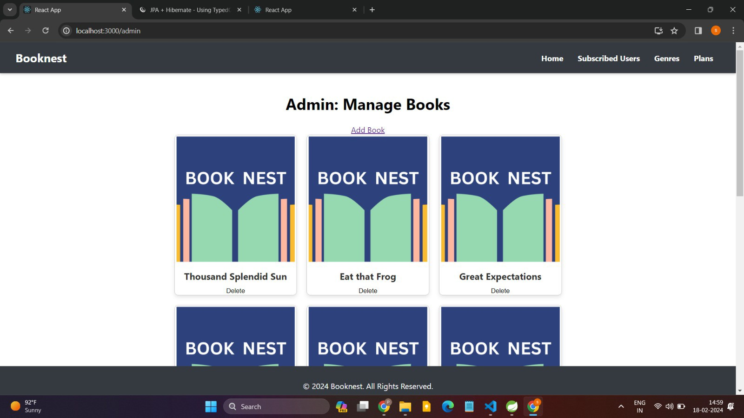
Subscribed users for admin-
Manage Books for admin-

Slide 16
Login to User-
USER LOGIN
This feature used by the user to login into system. They are required to enter user id and password before they are allowed to enter the system .The user id and password will be verified and if invalid id is there user is allowed to not enter the system.
Functional requirements
-user id is provided when they register
-The system must only allow user with valid id and password to enter the system
-The system performs authorization process which decides what user level can acess to.
-The user must be able to logout after they finished using system.

Slide 17
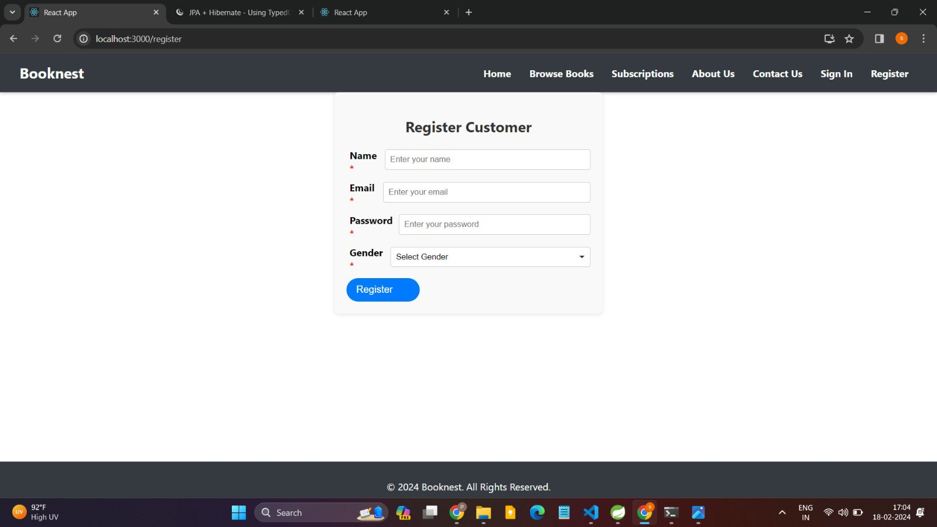
Register New user-
REGISTER NEW USER
This feature can be performed by all users to register new user to create account.
Functional requirements
-System must be able to verify information
-System must be able to delete information if information is wrong

Slide 18
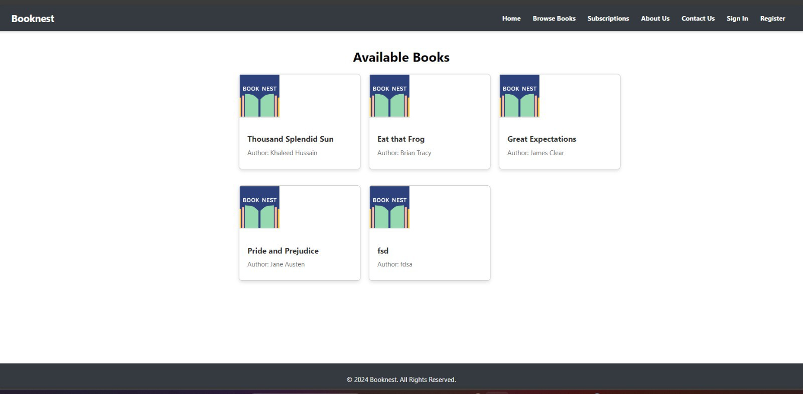
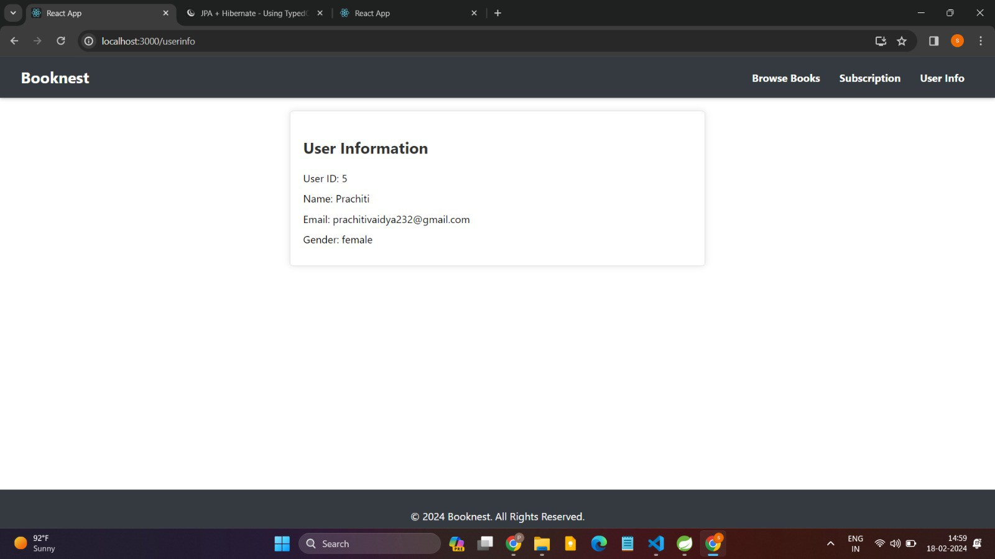
Screenshot of Available book books for Register Users -
Screenshot of User information-

Slide 19
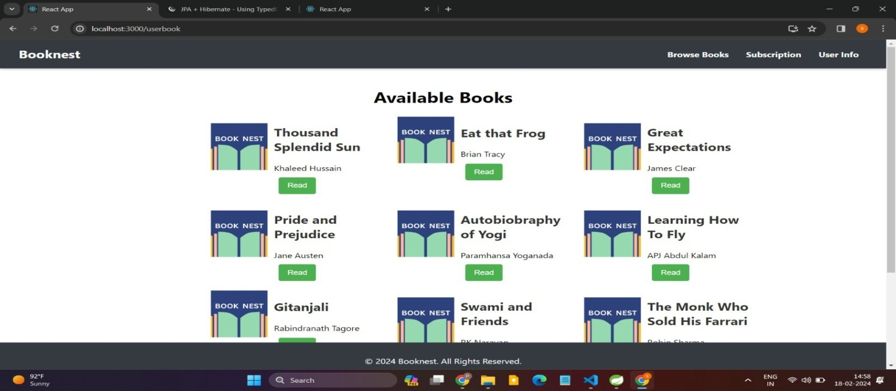
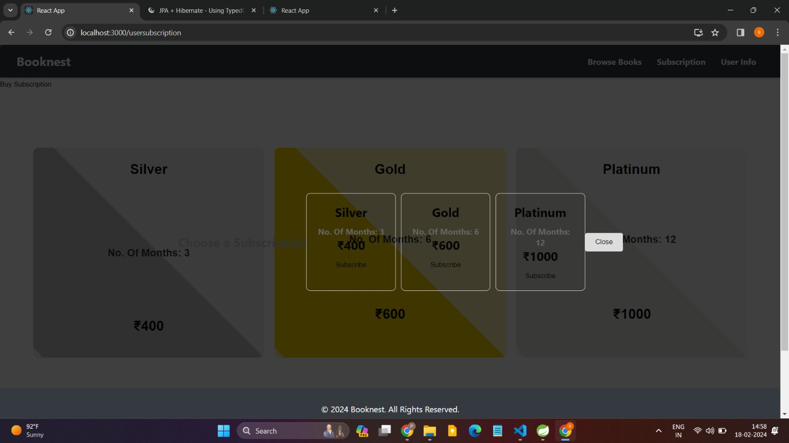
Available books for User-
Subscription for register user-

Slide 20

View Book for Users-
Future Scope -
Payment Gateway Integration:
Integrate popular payment gateways to enable seamless purchasing or subscription options for accessing premium content.
Support multiple currencies and payment methods to cater to a global user base.
Enhanced Security with Jwt Token:
Implement Jwt Token, a cutting-edge security protocol, to enhance data encryption and protect user privacy.
Utilize blockchain technology for secure transactions and transparent access control, ensuring the integrity of user data.

Slide 21

Limited Book Pages for Visited Users:
Introduce a limited preview feature, allowing users to access a certain number of book pages for free before requiring a subscription or purchase.
Customize the preview duration or page limit based on user engagement metrics and content popularity.
Navigation from Previous Read Page:
Enhance user experience by enabling seamless navigation from the previous read page, allowing users to pick up where they left off across devices.
Implement bookmarks and reading history features to track user progress and provide personalized recommendations based on reading habits.
Integration with Social Platforms:
Facilitate social sharing of book excerpts, reviews, and reading progress on popular social media platforms, enhancing user engagement and expanding the platform's reach.
Implement social login options to streamline user registration and authentication processes, leveraging existing social profiles for a frictionless user experience.

